Slide 1
Understanding Resilience Testing
by Mithun Kotian

Slide 2

Recognise This?

Slide 3
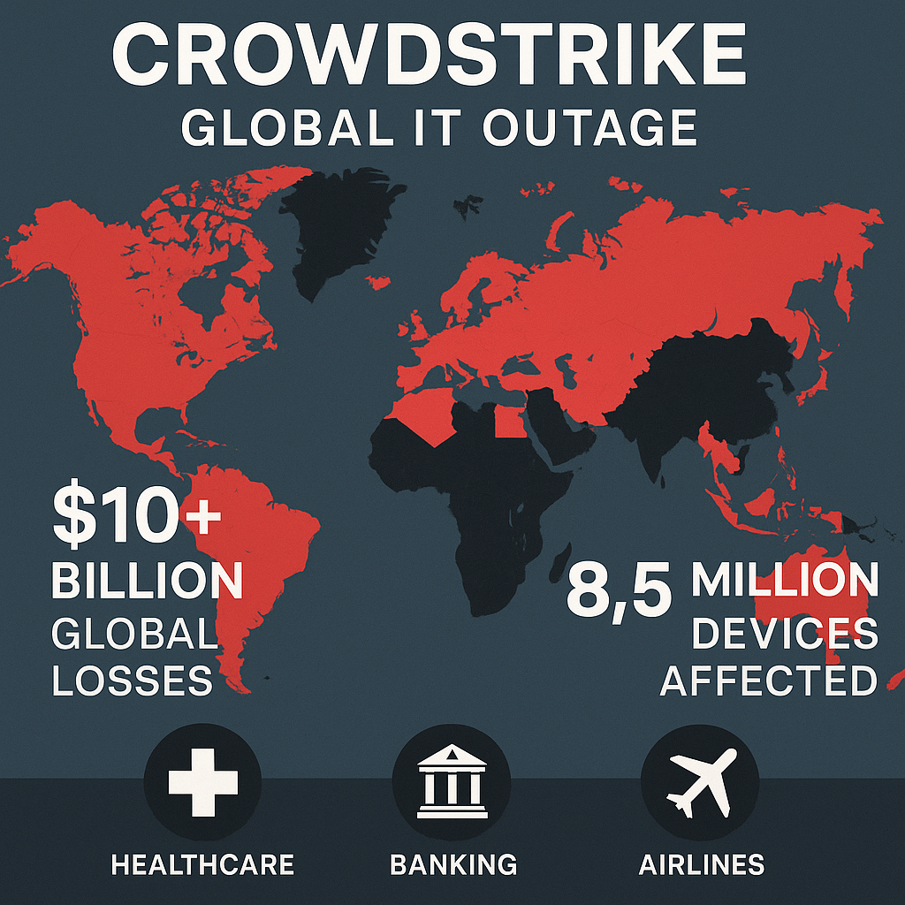

Slide 4
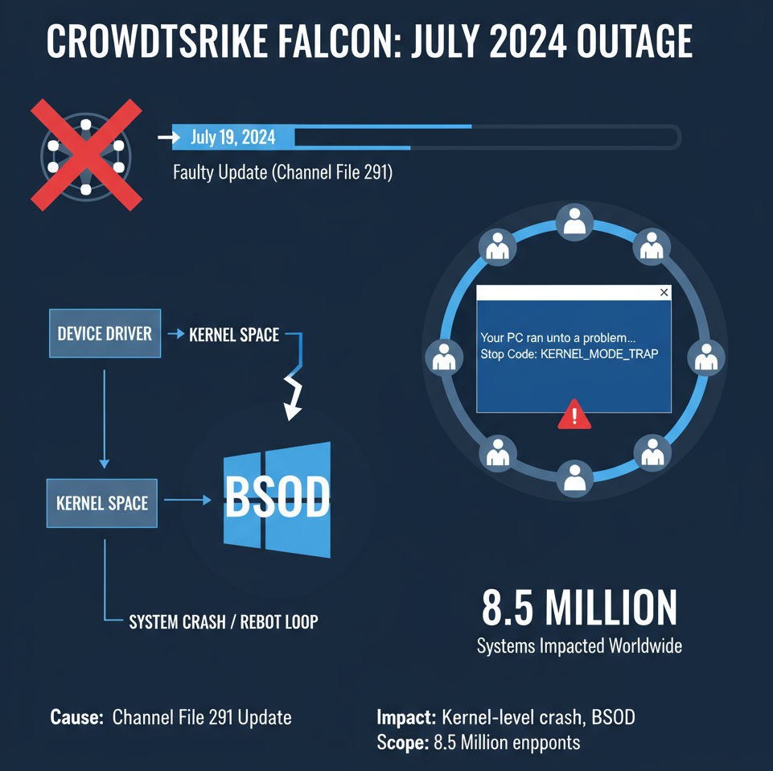

Slide 5
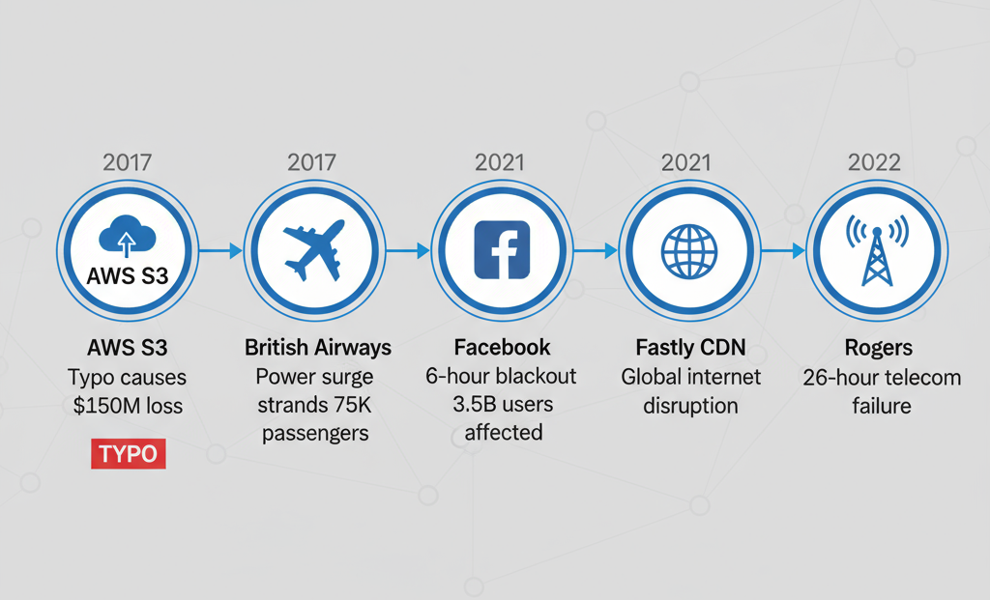

Slide 6



Impact of Failures
OPERATIONAL DISRUPTIONS
REPUTATIONAL DAMAGE
MONETARY DAMAGES

Slide 7
Resilience
the capacity to withstand or to recover quickly from difficulties; toughness.

Slide 8
Resilience (the sw definition)
Software resilience is the ability of software to withstand unexpected events and continue to function as intended.

Slide 9
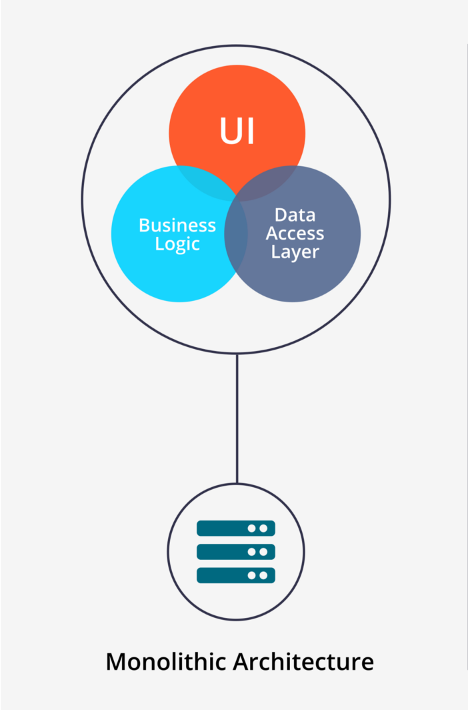
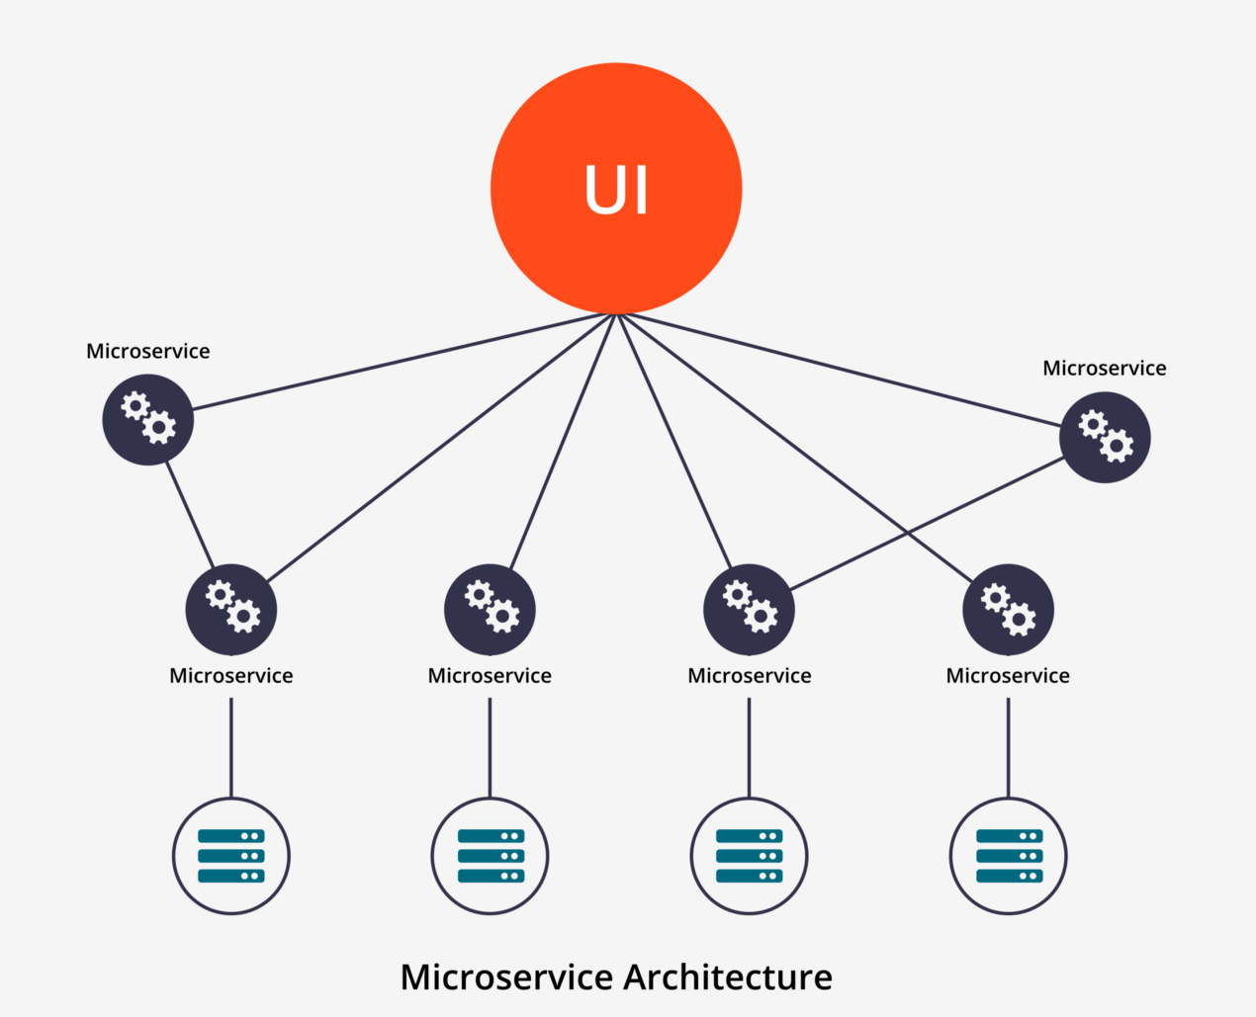

Slide 10
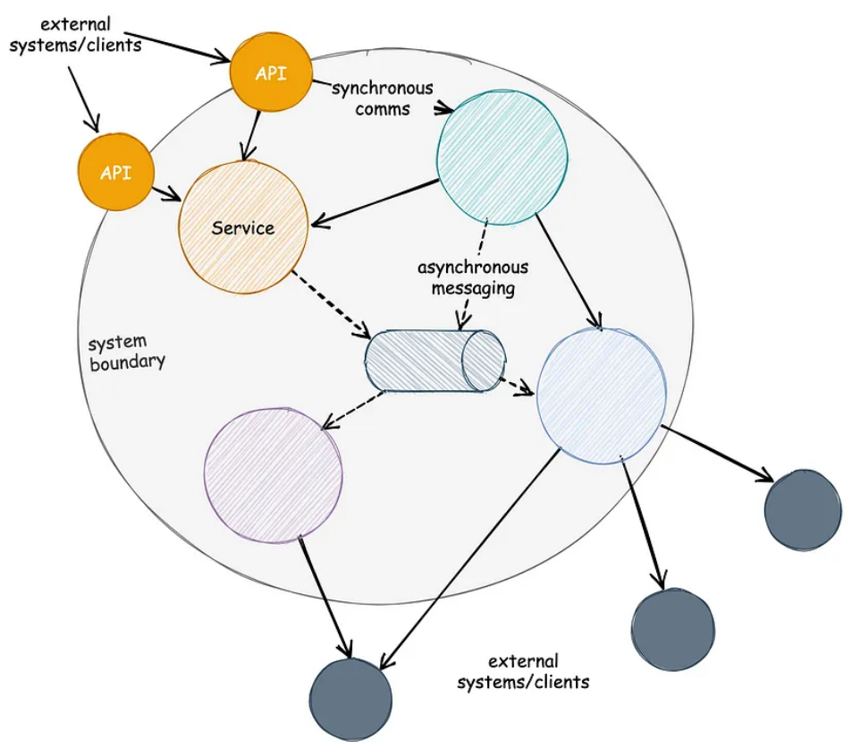
Typical Microservices Architecture

Slide 11
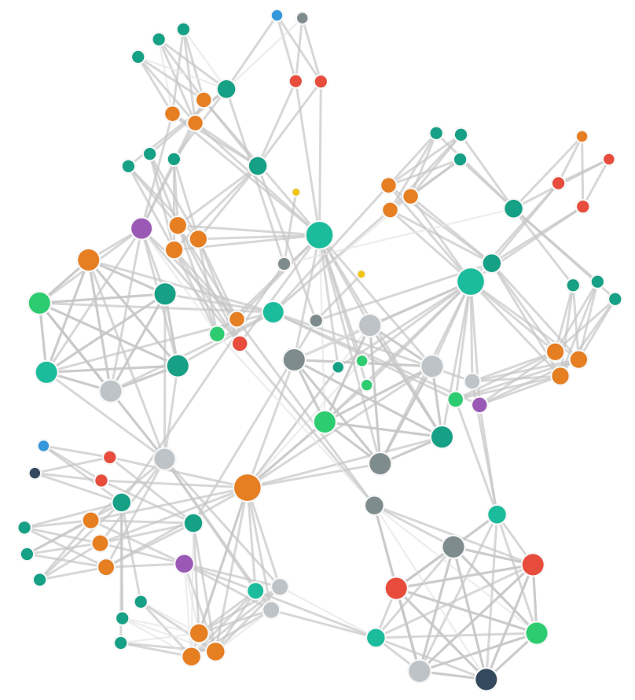
REAL WORLD MICROSERVICE GRAPH
Needs complex networking
Containerization adds complexity in network
Large Scale network traffic
Creates many unique types of intermittent/transient network related issues

Slide 12
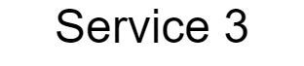
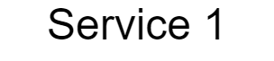

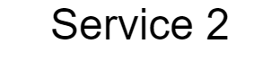
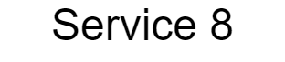


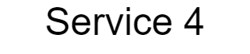


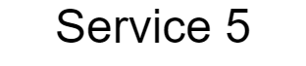
CASCADE SCENARIO

Slide 13
CASCADE SCENARIO

Slide 14
CASCADE SCENARIO

Slide 15
CASCADE SCENARIO

Slide 16
CASCADE SCENARIO

Slide 17
CASCADE SCENARIO

Slide 18
CASCADE SCENARIO

Slide 19
CASCADE SCENARIO

Slide 20
A SOLUTION
Circuit Breaker Design Pattern

Slide 21
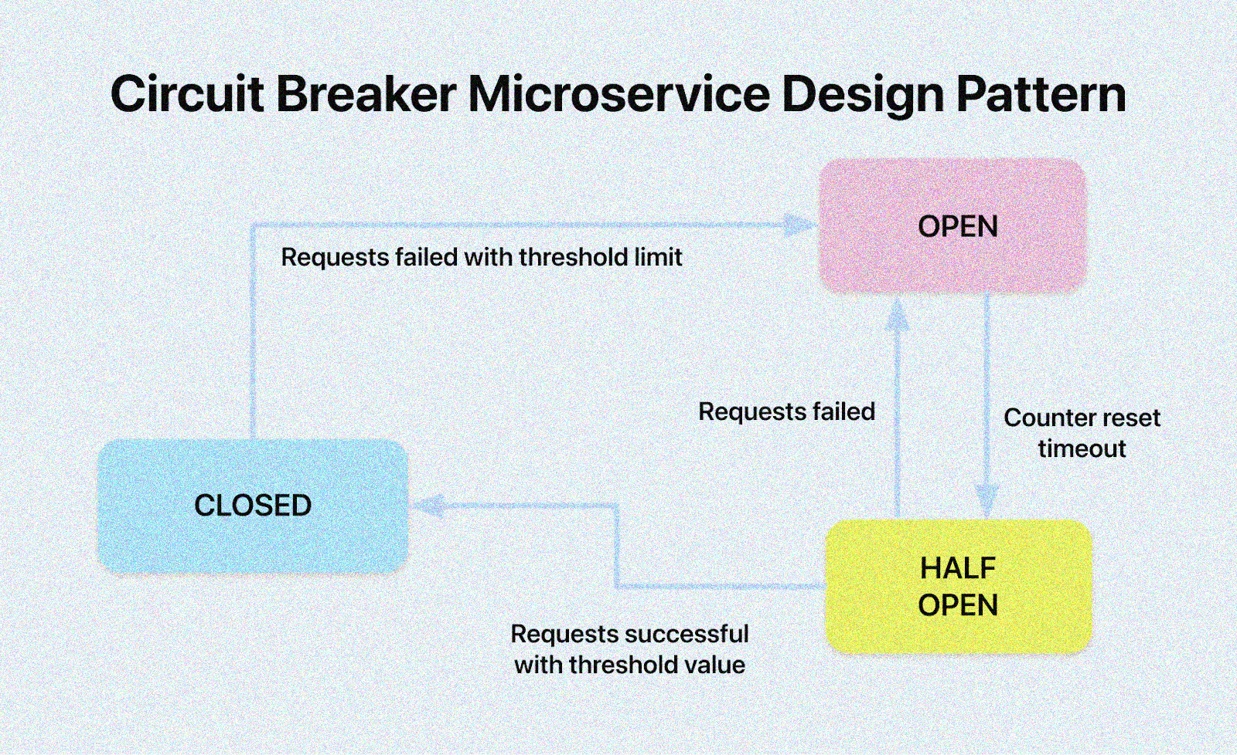

Slide 22
CASCADE SCENARIO AFTER CIRCUIT BREAKER

Slide 23

CASCADE SCENARIO AFTER CIRCUIT BREAKER
Cache

Slide 24
Why do you need to do Resiliency Testing?

Slide 25


One of the key features of microservices is reliability.
What For a system to be reliable, each component microservice should be reliable as well. Reliability is often measured
How Fault Tolerance, Fault Detection, Defensive Strategy

Slide 26
Reliability comes from Resilience

Slide 27
The Bane of Reliability
hardware failures individual hosts, host configuration, data centers, physical network, OS
communication breakage network connectivity failure, inadequate firewall configuration, DNS errors, messaging failure
dependencies failure timeouts, no backwards compatibility, internal component failure, external dependencies
service practices poorly designed system, other issues

Slide 28
The Fix for Reliability
Retries
Caching
Graceful Degradation
Timeouts
Deadlines
Circuit Breakers
Service Health Checks
Rate Limits

Slide 29
Purpose of Resiliency Testing
Reduce Downtime and Minimize Disruptions
Enhance System Availability
Identify and Address Vulnerabilities
Improve System Stability
Build Confidence in System Reliability
Notes:
Purpose of Resiliency Testing
It is crucial for building reliable and highly available systems that can maintain their functionality even in the face of unforeseen circumstances. It helps organizations achieve the following objectives:
Reduce Downtime and Minimize Disruptions: By proactively testing for failures, organizations can minimize downtime and prevent costly outages that can impact customer satisfaction, revenue, and overall reputation.
Enhance System Availability: Resiliency testing ensures that systems can remain operational and accessible even under challenging conditions, ensuring continuous service delivery and user experience.
Identify and Address Vulnerabilities: The testing process exposes potential weaknesses and vulnerabilities in the system's design, architecture, or dependencies, allowing for timely remediation and mitigation of risks.
Improve System Stability: Resiliency testing contributes to a more stable and robust system that can handle unpredictable events and maintain consistent performance under varying loads and conditions.
Build Confidence in System Reliability: By demonstrating the system's ability to withstand disruptions, organizations gain confidence in its reliability, resilience, and ability to meet business continuity requirements.

Slide 30
What do you need to know to do Resiliency Testing?
System Architecture Diagram for the Application or Microservice
List of Scenarios for each of the dependencies
A way to execute the scenarios

Slide 31
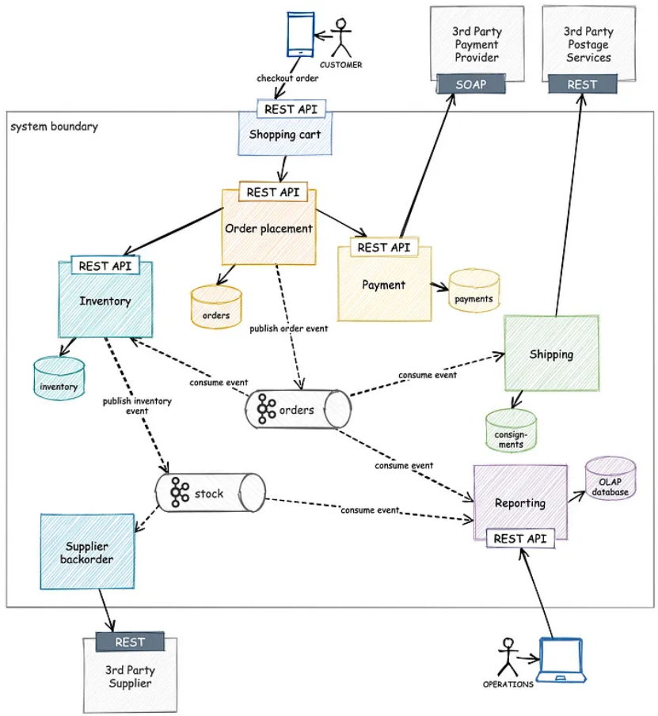
This is an example microservices based system, based on a ecommerce application

Slide 32
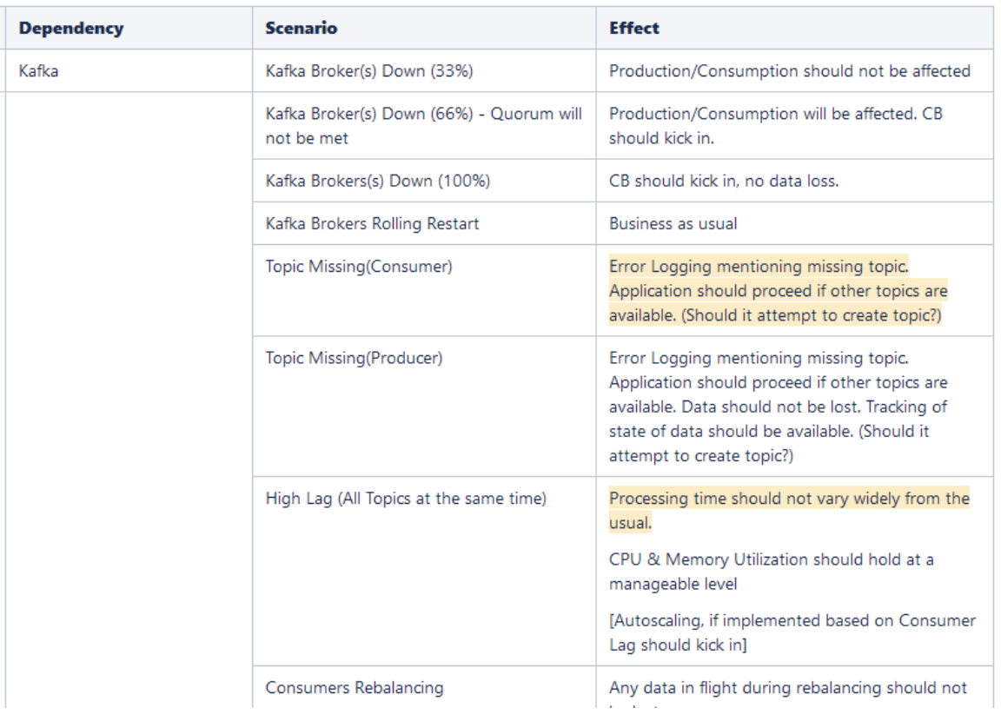
Scenarios

Slide 33
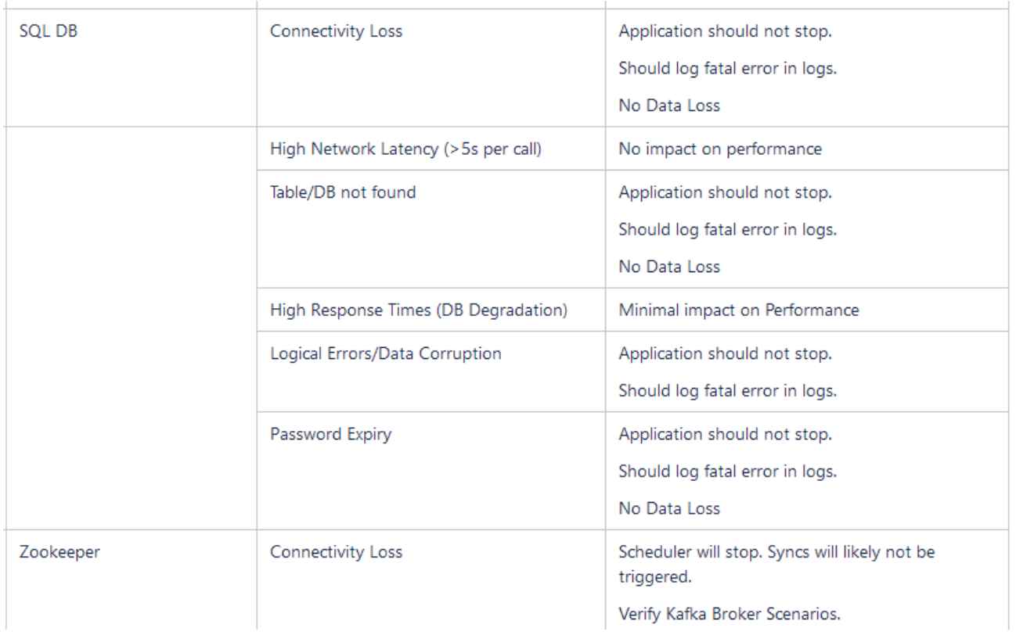
Scenarios

Slide 34
One good way to get started with Resilience Testing is to use Fault Injection.

Slide 35
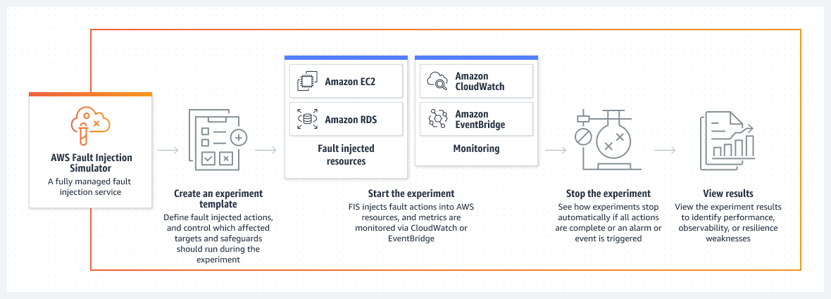
AWS Fault Injection Service

Slide 36
Another good way is to use toxiproxy.

Slide 37
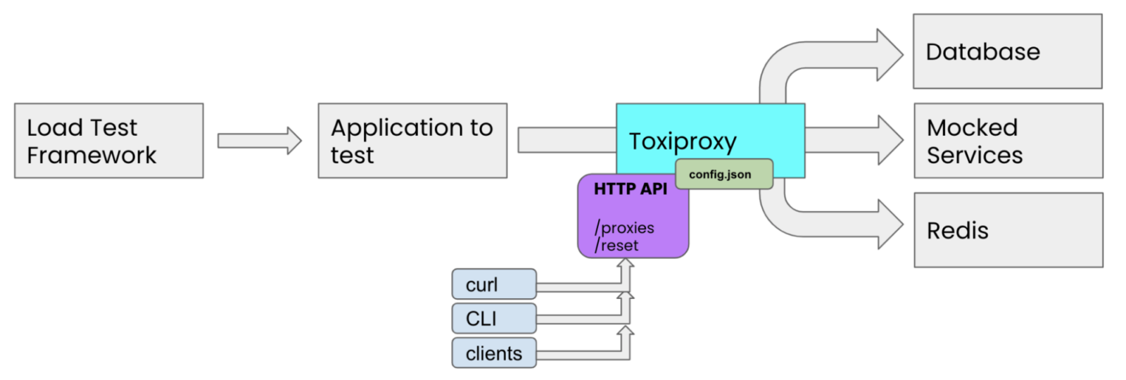

Slide 38
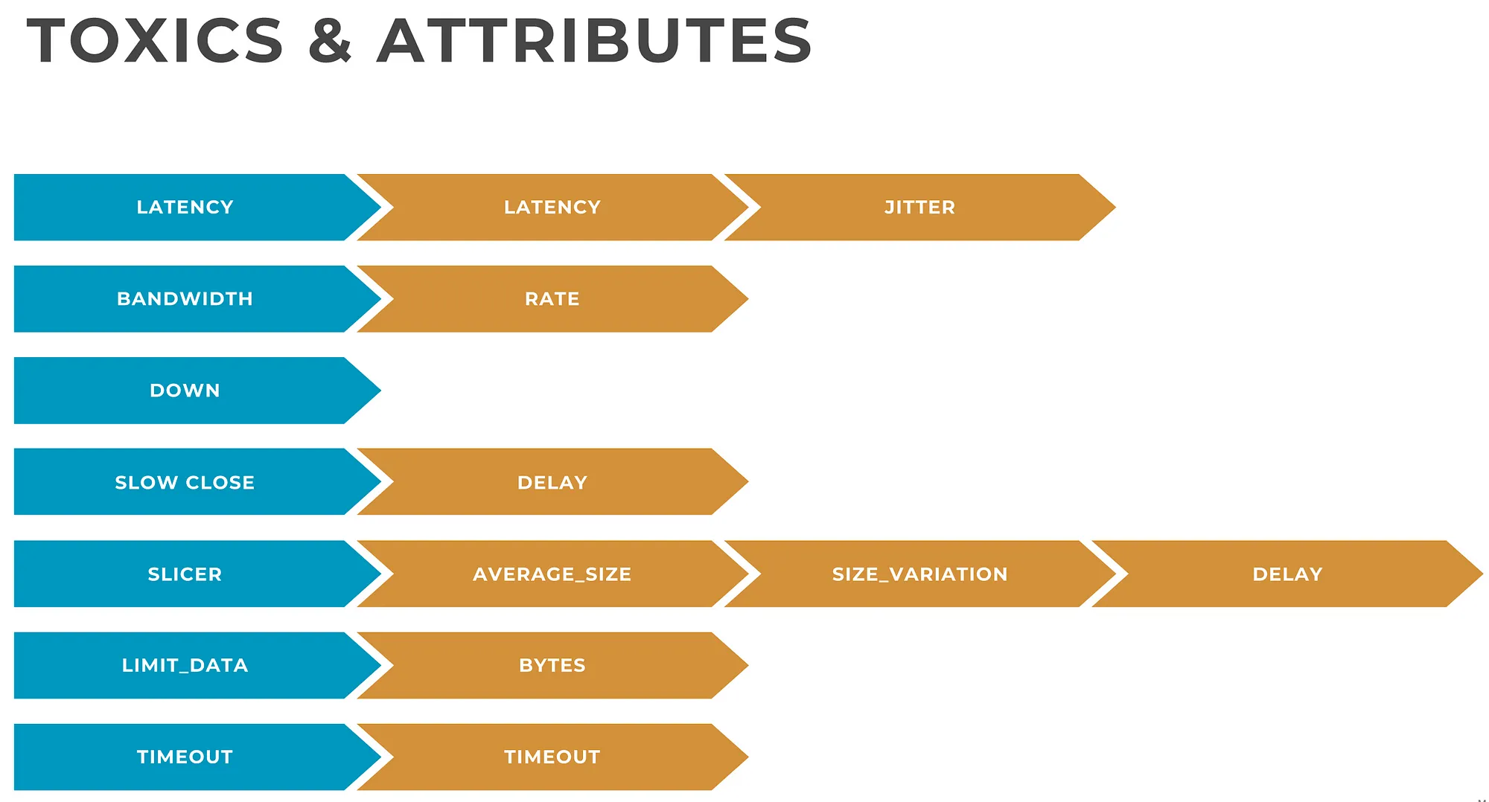

Slide 39
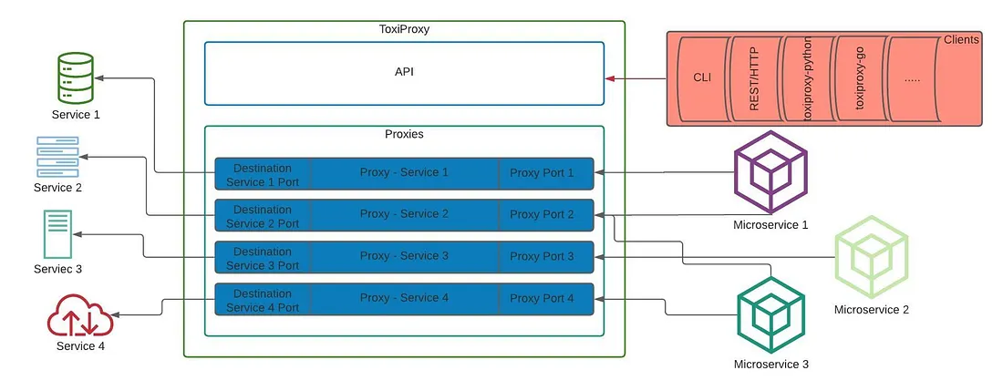

Slide 40
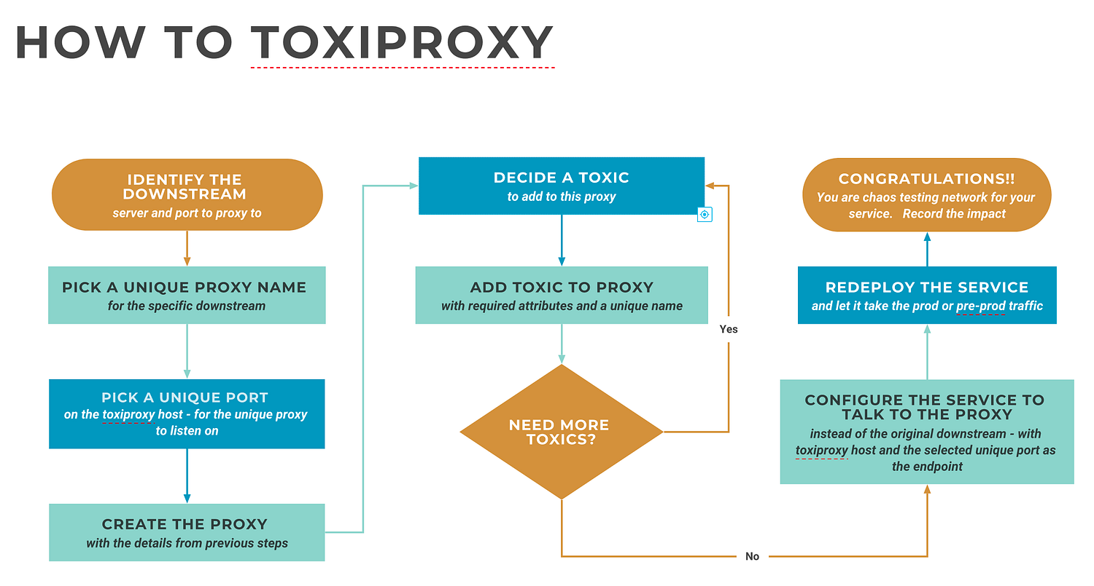

Slide 41



Other Tools

Slide 42
Testing leads to Failure,
Failure leads to Understanding.

Slide 43
Thank You!

Slide 44


Slide 45
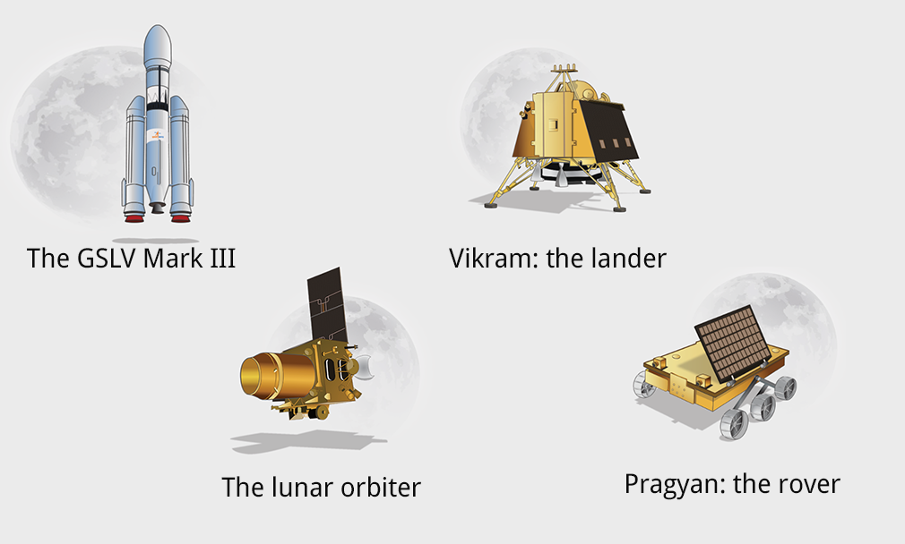

Slide 46
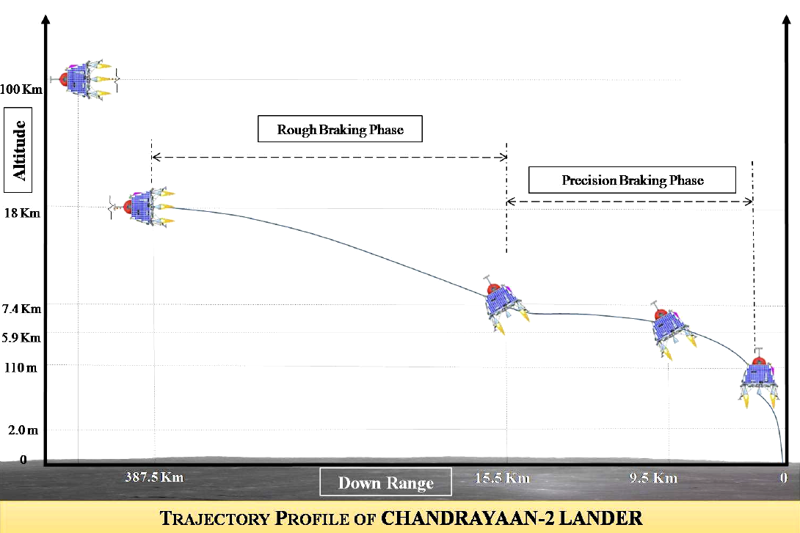

Slide 47
What changed between 2 & 3?
Added redundancies in Hardware
Strengthened landing legs
Improved Targeting Algorithm
Optimized limits imposed on hardware
Developed new sensors to add redundancy to telemetry
Extensive testing of permutations & combinations of wrong parameters
Sensor testing using IAF Planes & helicopters
Software simulation of millions of combinations of inputs to ensure edge cases are not missed

Slide 48
